Slide 1

Do more than six stocks matter?
Springboard capstone project report (9/24/2016)
By David Whitney
Mentored by Sameera Poduri

Slide 2
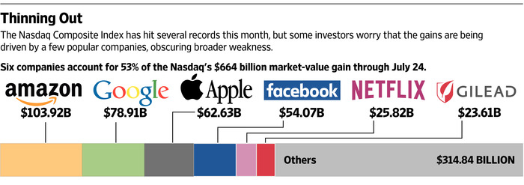
How important are these SIX stocks?
According to a recent Wall-Street Journal article, more than half the value added to the NASDAQ in 2015 came from the “FAANG” stocks alone.
Source: http://www.wsj.com/articles/the-only-six-stocks-that-matter-1437942926

Slide 3

Who are these SIX Stocks?
The FAANG stocks are a small group of high performing technology/ pharmaceutical-related companies:
Amazon (AMZN)
Apple (AAPL)
Facebook (FB)
Google (GOOG or GOOGL)
Netflix (NFLX)
Gilead (GILD)
Four of these companies (Facebook, Amazon, Netflix, and Google) have been affectionately dubbed by Jim Cramer on Mad Money by the acronym ‘FANG.’
So as not to be confusing, the six listed stocks above will be dubbed by ‘FAANG’ in this report.

Slide 4
IS THE MARKET RECOVERY LOPSIDED BECAUSE OF FAANG?
As the NASDAQ composite’s recent growth has been so heavily concentrated in the FAANG stocks, concerns have been raised about the robustness of the recent recovery in the U.S. stock market.
For example, the FAANG stocks have closely tracked with the NASDAQ, providing some evidence for this viewpoint:
NASDAQ
APPL
AMZN
FB
GOOG
GILD
NFLX

Slide 5
BUT IT’S NOT JUST THE FAANG STOCKS!!!
Other leading stocks in the Top 100 NASDAQ list (excluding the FAANG stocks) also track the NASDAQ very closely!
But sadly it’s not all stocks…
Instead the bulk of NASDAQ stocks appear to have collectively stagnated over the last five years.
Note: All data has been z-scored, so they can be more easily compared

Slide 6
BUT IT’S EVEN MORE THAN THE 100 NASDAQ stocks GROWING
When we compute the normalized growth rate of every NASDAQ stock (i.e. the slope of the historical stock traces), we can see that ~70-80% of Top 100 NASDAQ and ~20-30% of regular NASDAQ stocks show growth consistency comparable to FAANG stocks.
That means >20% of NASDAQ stocks are showing consistent growth!
FAANG
TOP 100
OTHER

Slide 7
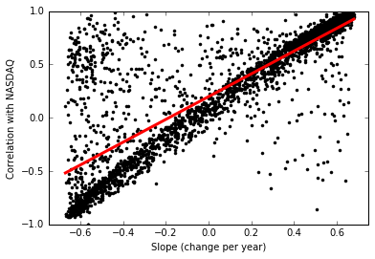
THESE SAME STOCKS ARE HIGHLY CORRELATED WITH THE NASDAQ
We can also observe that if a company tracks with the NASDAQ closely (i.e. high-correlation values), this company has a strong tendency to exhibit positive growth!

Slide 8
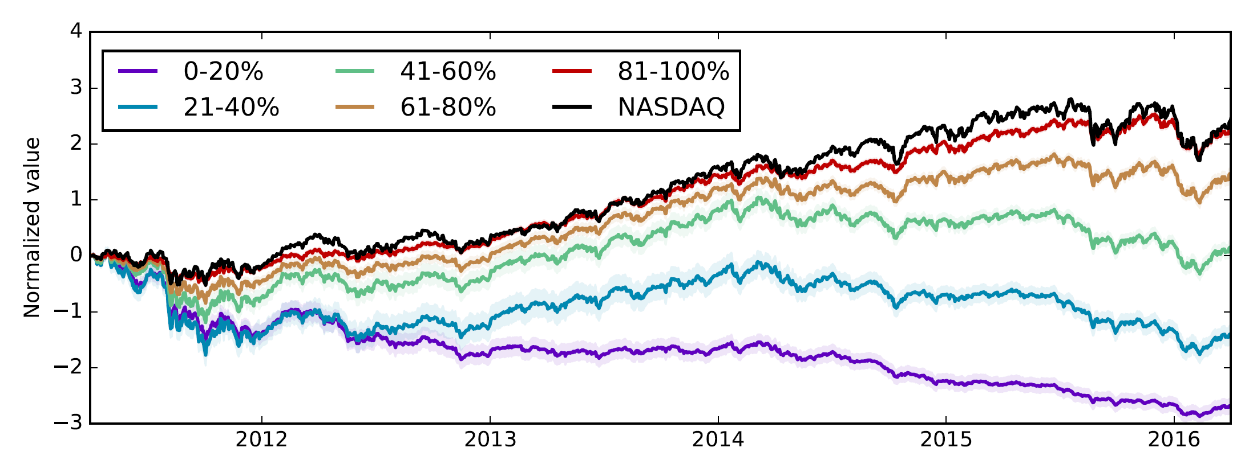
CAN WE VISUALIZE THIS EFFECT?
If we systematically split the 2800+ NASDAQ companies into five groups based on how well the companies are correlated with NASDAQ, we can see that the top 20% track the NASDAQ closely!

Slide 9
CONCLUSIONS
While FAANG stocks closely co-vary with the NASDAQ Composite Index, these stocks do not behave fundamentally different than many other NASDAQ stocks.
In fact, 20-40% of other NASDAQ stocks also closely co-vary with the NASDAQ.
This group of stocks includes most Top 100 NASDAQ stocks.
For the last five years, stocks that closely co-varied with the NASDAQ tended to show consistently positive growth.
Thus, there are many other growing companies that warrant a look by investors!
Furthermore, while capital might be heavily concentrated in the FAANG stocks, consistent growth in ~20-40% of NASDAQ stocks is an encouraging sign that the market recovery has not been purely driven by a handful of stocks.

